Slide 1
Grambling State University
State Travel Card/CBA (Controlled Billed Account)
By Erin Walker

Slide 2

Overview
Introduction & Purpose
Benefits
Card Controls
Cardholder Responsibilities
How the Program Works
Important Information

Slide 3
What is a University Travel
University Travel refers to travel that is officially authorized and directly related to conducting University business on behalf of Grambling State University.
✔️ Key Characteristics
Must have an approved Travel Authorization (TA) before travel occurs. Expenses must be necessary, reasonable, and allowable under University and State Travel policy
Travel is conducted for official business purposes, such as: Conferences and Workshops, Recruitment or Athletic competitions, Meetings, training, or Research
⚠️ Important Reminder: Personal travel or expenses not related to official University business are not considered University Travel and are not reimbursable.

Slide 4

Introduction and Purpose
What is the State Travel Card/CBA
The State Travel Card is a VISA credit card issued by Bank of America (BOA) and is used by GSU employees to pay for specific, authorized travel expenses.
The CBA (Central Billing Account) is a cardless billing account issued to the University for approved travel-related expenses.
These tools are used to manage official travel and related accounting.
The individual whose name is assigned to the State Travel Card or CBA is solely responsible for all transactions made on the account. The card or account may not be used by anyone else.
The State Travel Card and CBA may be used only for authorized travel expenses related to official state business.
Approvers are responsible for approving only those transactions that are appropriate, compliant, and directly related to official state business.

Slide 5
Benefits of the University CBA Card
University Benefits
Centralized payment for approved travel expenses
Improved compliance with State (PPM-49) and University policies
Simplified accounting, auditing, and reporting
Better cost control and budget oversight
Reduced risk of unauthorized or personal charges
Traveler & Department Benefits
Reduced out-of-pocket expenses for travelers
Faster payment to airlines, hotels, rental car, and conference vendors
Fewer or no travel advances required
Streamlined travel authorization and payment process
Time savings for travelers and approvers

Slide 6




Purpose of the Program
Purpose: Payment of approved travel expenses
Four required items for State Travel Card or CBA use:
Airfare
Lodging
Vehicle Rental
Registration fees
(Membership fees only if included with registrations)

Slide 7







Unauthorized Purchases
Cash advances – cash instruments, cash refunds
Controlled substances (prescription drugs, narcotics, etc.)
Entertainment costs – ski tickets, tours, etc.
Alcoholic beverages
Gift Cards/Gift Certificates
Personal purchases
Meals & AV equipment (unless prior approval through the Office of State Travel – requests must be sent to your Administrator). Signed (wet) roster of participants is required for food/drink.

Slide 8





Authorized Purchases
Airfare
(No Baggage fees, unless Prior approval is obtained)
Internet Services
Only with hotel stay & combined on invoice
Hotel/Lodging and Contracted travel agency fees
Rental Car
ENTERPRISE/HERTZ
Parking
Only with hotel stay and combined on invoice
Registration for conferences/workshop
Membership dues if combined

Slide 9

Before you Start Checklist
Approved Travel Authorization (TA)
Conference Agenda or Flyer
Hotel Reservation: Traveler name(s) & Confirmation number
Enterprise Reservation: Traveler name & Confirmation number
Car Rental Booking Form
Airfare Quote
Conference Registration: Quote or invoice
GSA Rate and/or Conference Rate Confirmation
Signed Payroll Deduction Form (if applicable)
Encumbrance: Must be in the traveler’s name & Must be fully approved
Prior Approval Letters (if required)
Wet Roster (required when traveling with a group of students)
Do
you
have…

Slide 10
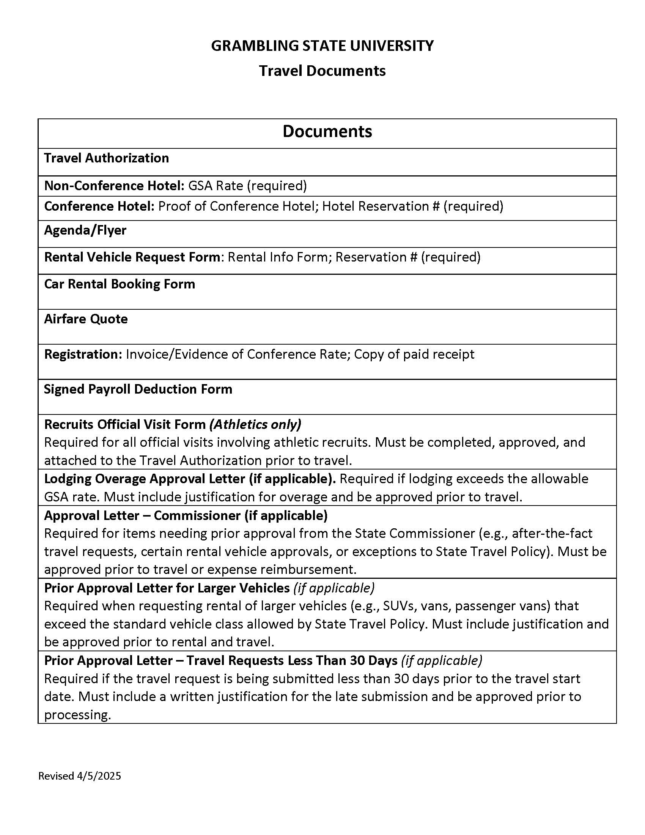
📋 Ready, Set... Wait!
Do You Have Everything
You Need?

Slide 11
Vehicle Rental
Premium or Special Elite vehicle rentals are not permitted.
Upgrades require prior approval and must be obtained before making a reservation.
Travelers must provide Ms. Becky Fields with an approved Travel Authorization (TA) and Encumbrance to obtain a University Gas Card.
Prior approval is required for any vehicle upgrades and/or out-of-state rentals.
A formal written justification must be submitted to the Vice President and President.
  Requests must be routed through the Program Administrator for required signatures.
  Approval template is available on the Travel website.
Refueling charges and violations (including citations) are not permitted.
The cardholder and approver must ensure the traveler reimburses Grambling State University within three (3) business days following travel for any refueling or other charges not related to official travel on the CBA card.

Slide 12
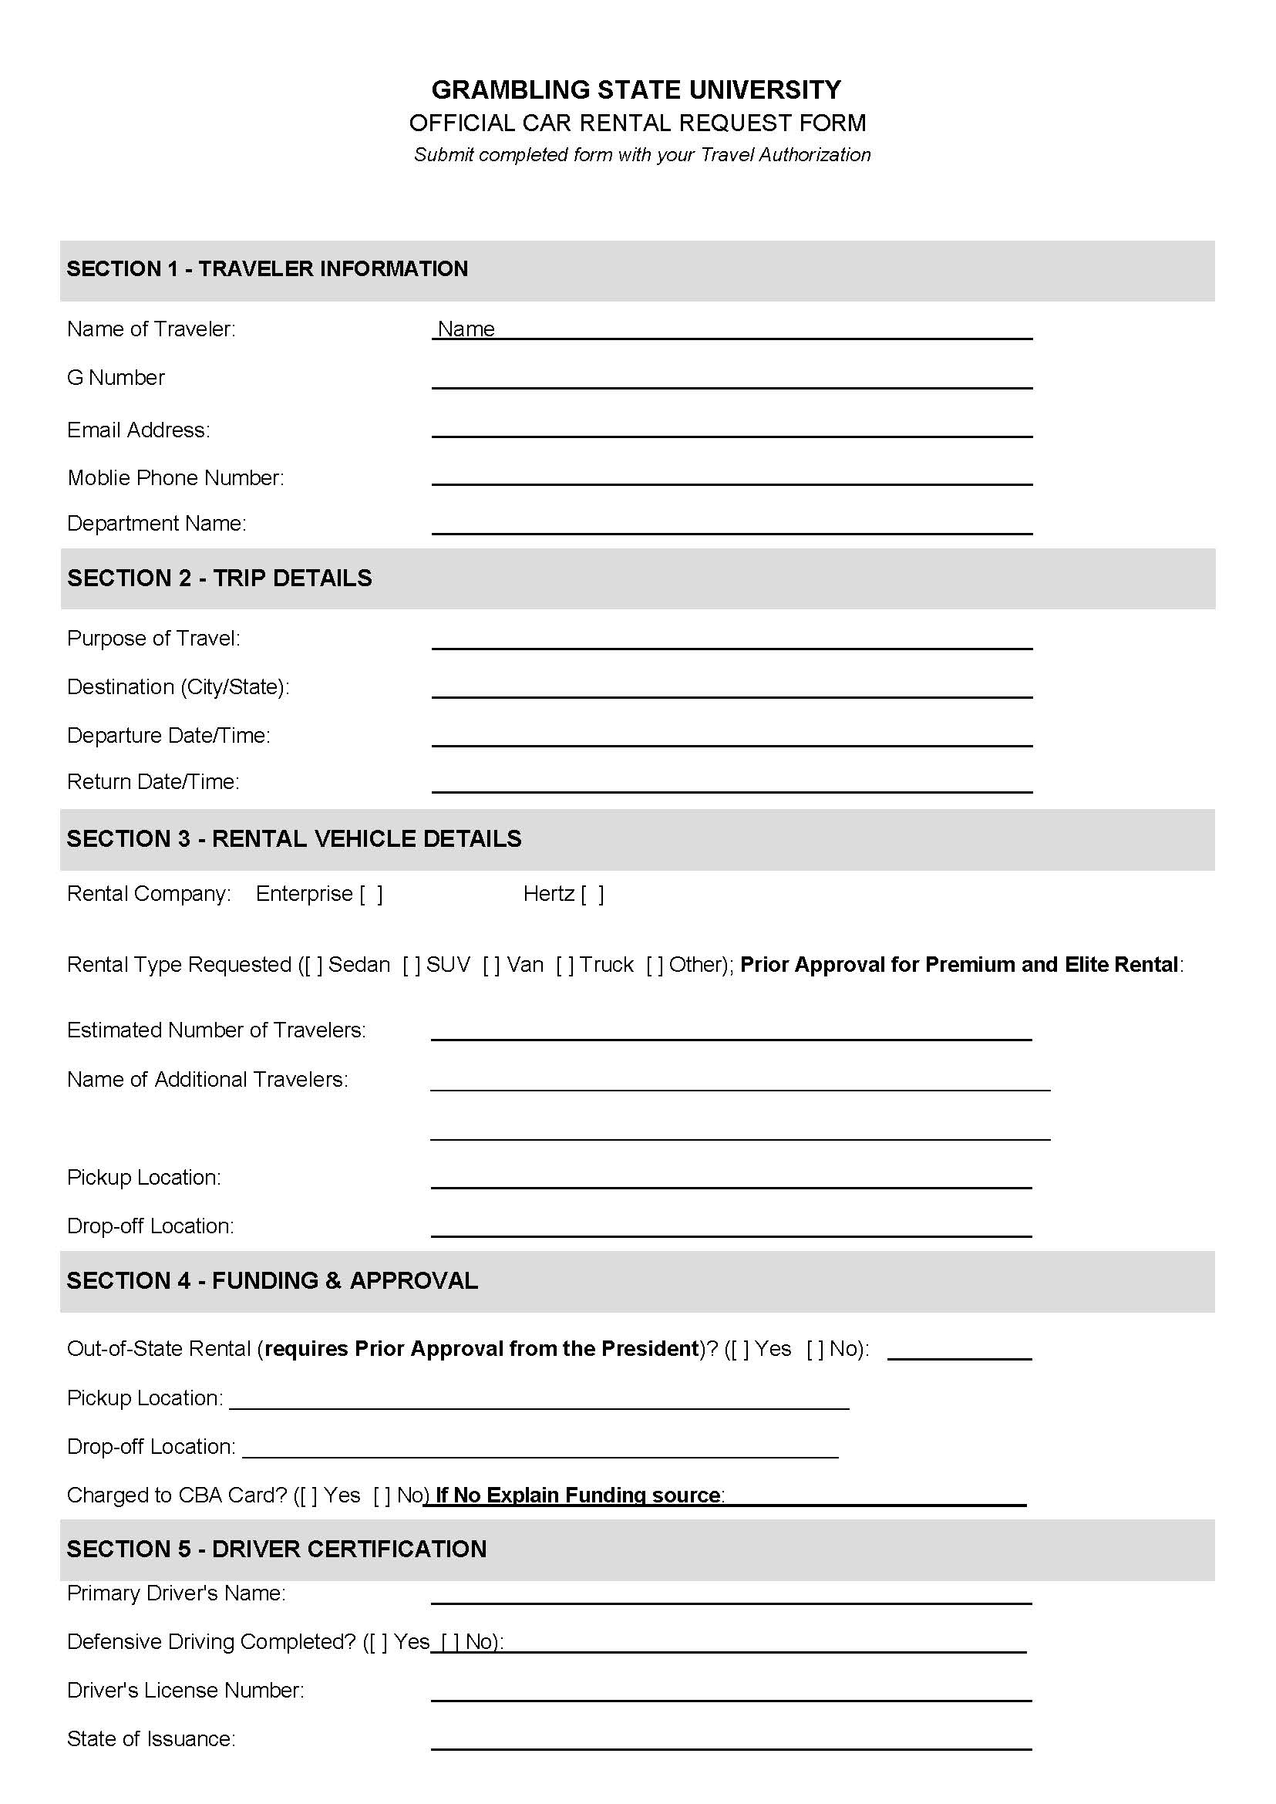
Vehicle Rental Form
Per OST (Office of State Travel) policy, travelers must complete the State-required Driver Defense Course and hold a valid driver’s license in good standing to be authorized to rent a vehicle.
Premium or Special Elite vehicle upgrades are not permitted, per the University or OST.

Slide 13
Hotel/Lodging
Requirements
Reservation confirmation number must be in the traveler’s name
Screenshot of the GSA rate for the destination area is required
Prior approval from the Vice President and President is required if lodging exceeds the GSA rate, in accordance with University policy
A personal credit card is required at check-in
  No incidental charges are allowed on the University CBA card
Louisiana hotels must honor the University’s tax-exempt status
  If taxes appear on the final invoice, the traveler must have them removed prior to checkout
Consequences of Non-Compliance
Travel requests may be delayed or denied
The traveler, cardholder, and approver will be responsible for any incidental charges

Slide 14
Airfare Requirement
An airfare quote is required at the time you submit your Travel Authorization (TA).
The quote helps confirm availability, pricing, and compliance with State travel guidelines.
Once the Travel Team begins reviewing your travel request, they will contact you directly with the next steps to secure your flight.
Do not purchase airfare independently unless specifically instructed by the Travel Team.

Slide 15
🚫 When a Travel Request May Be Denied
Travel Request Denials
Travel requests may be denied within ten (10) business days of travel if required documentation or prior approvals are missing, or if the request does not comply with University or State travel policy.
Common Reasons for Denial
Missing or incomplete documentation
Required prior approval letters not submitted
  Less than 30-day notice
  Hotel overage
  Rental upgrades
GSA rate documentation not provided
Payroll Deduction Form not submitted
Incomplete or unapproved encumbrances

Slide 16
Purchases
Verify funding is available in your budget.
Ensure transaction is appropriate for the State Travel Card.
Provide vendor with completed and signed tax-exempt form.
  If sales tax is charged, the cardholder, approver and the traveler is responsible for refunding the University.
Obtain an itemized receipt.
  General receipts and some handwritten receipts are not sufficient if administrators and auditors cannot view what was purchased.

Slide 17
Other Purchase Information
Resort fees are reimbursable, but the rate and fee cannot be more than the GSA rate for the area, not including conference rate for the actual conference hotel
For conference hotels over the routine GSA Rate – Documentation must be attached to the Travel Authorization.
NO Louisiana state tax is to be charged on the card, if so it must be credited by the vendor or reimbursed by the cardholder, approver, and traveler. Non-state occupancy or other taxes on hotels are acceptable. Sales tax is allowed for parking only in the New Orleans area, if on hotel invoice.

Slide 18
Adjustments to the Travel
A Travel Adjustment Form must be submitted when there are changes to a (existing) or approved travel request, including any of the following:
Changes or additions to the traveler's name(s)
Increases in trip costs, including:
  Hotel
  Airfare
  Registration fees
Cancellations
  *Form is located on the travel webpage: https://gram.edu/offices/infotech/teleworking/travel.php

Slide 19
Other Important Information
The State CBA card is to be used for official university business only. Violators of policies & procedures will be subject to disciplinary action.
Violations:
Personal or unauthorized purchases such as hotel incidentals.
Alcohol

Slide 20
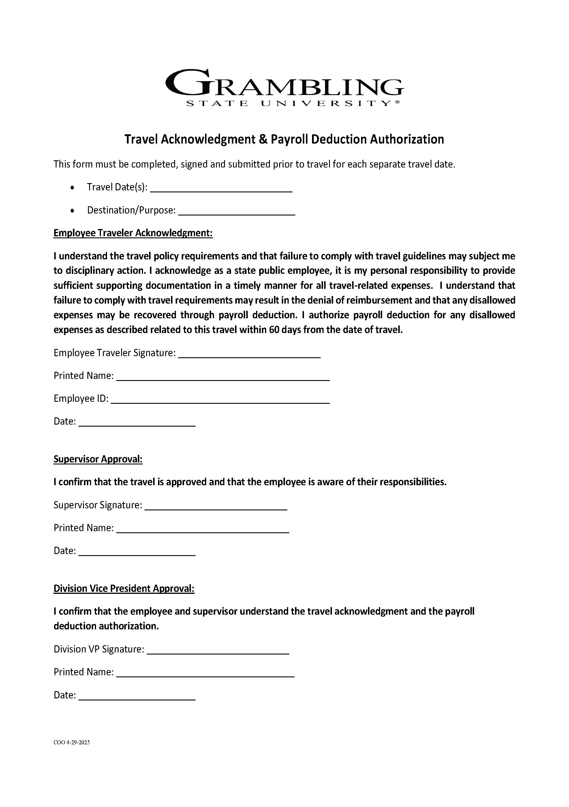
Other Important Information
Failure to comply with all State CBA Card policies & procedures may result in the following:
Payroll deduction- form on the right
Loss of Travel privileges on GSU CBA card
Notification to administration, internal audit, Office of State Travel, LLA (Louisiana Legislative Auditor) and University Police
Possible employment suspension or termination

Slide 21
Due Dates for Travelers
Conferences - the following documents must be submitted with the initial travel request: the agenda, flyer, and supporting documentation regarding the hotel rates.
TA will not be processed without the required supporting documentation. All documentation must be submitted in full to ensure compliance with university and state travel policies.
30-Day Requirement: Travel requests must be submitted 30 days in advance. Requests within 30 days require prior approval from the Vice President and President and are reviewed case by case.
*Template on the Travel page.
All hotels receipts must be submitted 3 business of return trip. All hotel receipts must have the following email address attached to the reservation’s travel@gram.edu no exceptions.
Traveler must obtain a receipt before leaving the hotel.

Slide 22
Travel Card Policies Locations
The State’s card policy can be found at:
The GSU Travel Card policy can be found at:
https://www.doa.la.gov/doa/ost/statewide-card-policy/
https://www.gram.edu/offices/infotech/teleworking/travel.php
For more information, please refer to the State PPM49 Policy https://www.doa.la.gov/media/faqdrej4/ppm49-2025-07-01.pdf

Slide 23
GSA Rates
https://www.gsa.gov/travel/plan-book/per-diem-rates
https://allowances.state.gov/web920/per_diem.asp
International GSA Rates
https://allowances.state.gov/web920/per_diem.asp
https://allowances.state.gov/content.asp?content_id=114&menu_id=75

Slide 24
Key Contacts
State Travel Card Administrators
Kimoni Perkins
318-274-3850
Chantia Spivey
318-274-6170
After Hour Number (ONLY)
318-957-6740
All Inquires please email travel@gram.edu

Slide 25

Questions

