Slide 1
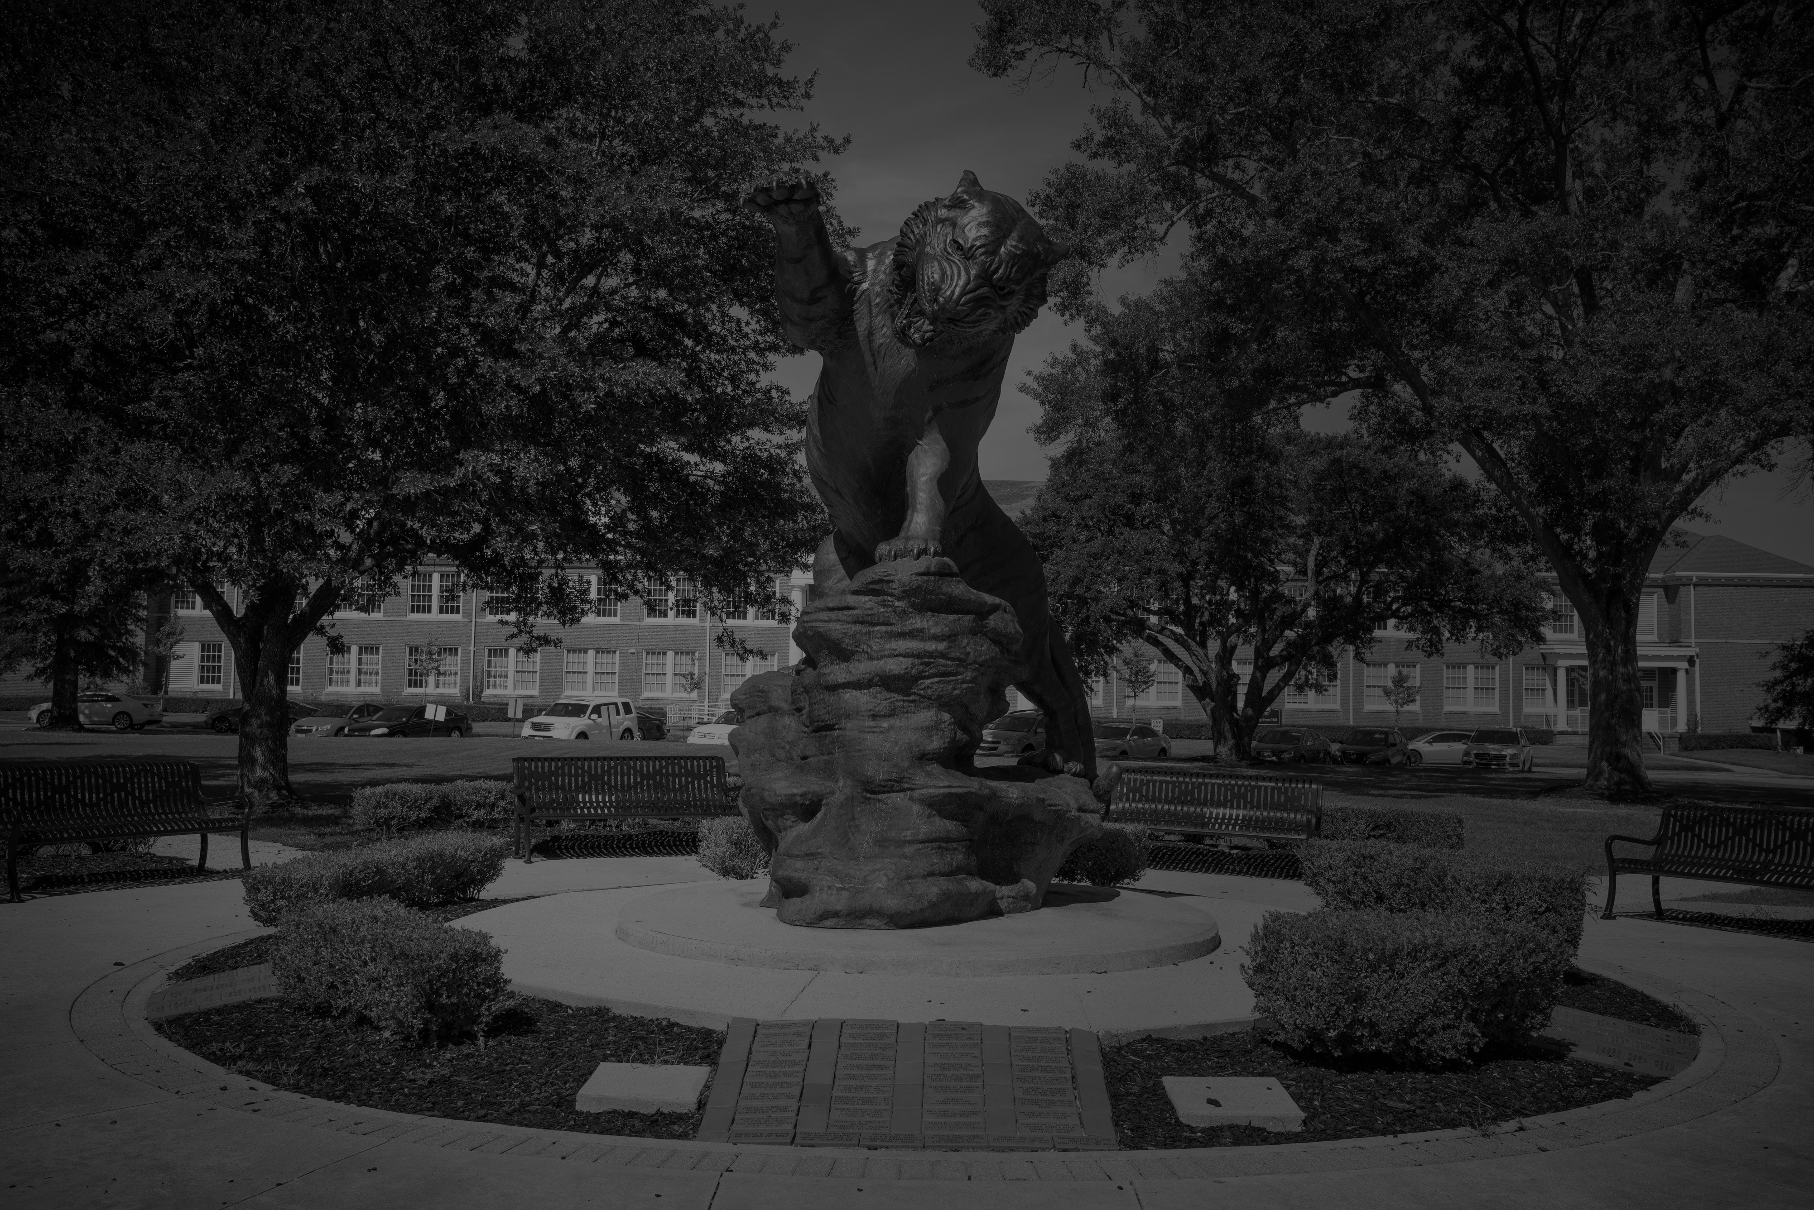

State Travel Training (Updated April 21, 2026)
STATE TRAVEL
TRAINING
APRIL 21, 2026

Slide 2
Meet our travel team
Erin Walker
Travel Supervisor & GSU Program Administrator
Controller’s Office/Travel Office
Office Phone : 318-274-3280
Email: walkere@gram.edu
Chantia Spivey
Travel Specialist
Office Phone: 318-274-6071
Email: spiveyc@gram.edu
Charity Akamnonu
Interim Travel Specialist
Office Phone: 318-274-3850
Email: akamnonucha@gram.edu
Willie Jefferson
Interim Travel Specialist
Office Phone: 318-274-6288
Email: jeffersonwi@gram.edu
AFTER HOURS PHONE NUMBER (ONLY) 318-957-6740

Slide 3
Travel Information
How do I get to GSU Travel Page?
  Gram.edu
  GSUNET
  DocuSign
  Travel Information

Slide 4
NEW EMPLOYEE ON BOARDING
It is the employee’s responsibility to connect with the Travel Office at travel@gram.edu in a timely manner to ensure eligibility for official university travel. Employees who do not complete the required travel training will not be permitted to travel on behalf of the university.
University Travel will host various training sessions throughout the year. However, it is essential that employees proactively reach out to the Travel Office, especially those in time-sensitive departments such as Athletics, to arrange immediate training as needed.
ALL employees, including current staff, are required to complete the travel training prior to engaging in any travel activities.

Slide 5
WHAT IS A University Travel
University Travel refers to travel that is officially authorized and directly related to conducting University business on behalf of Grambling State University.
Key Characteristics
  Must have an approved Travel Authorization (TA) before travel occurs. Expenses must be necessary, reasonable, and allowable under University and State Travel policy.
  Travel is conducted for official business purposes, such as: conferences and workshops, recruitment or athletic competitions, meetings, trainings, or research.
  *****Important Reminder: Personal travel or expenses not related to official University business are not considered University Travel and are not reimbursable.

Slide 6
Introduction and purpose
What is the State Travel Card/CBA
The State Travel Card is a VISA credit card issued by Bank of America (BOA) that is used by GSU employees to pay for specific authorized travel expenses. The CBA is a cardless billing account issued to the university for travel expenses.
Tools to manage travel and accounting.
The individual whose name is assigned to the CBA is responsible for all transactions made with the card. No one else can use either!
The card can only be used to pay for authorized travel expenses.
Approvers are responsible for approving only those transactions that pertains to official state business

Slide 7




AUTHORIZED PURCHASES
The four approved items that must be paid using a State Travel Card or CBA for approved travel expenses are:
AIRFARE LODGING VEHICLE RENTAL REGISTRATION FEES
(No baggage fees, unless prior approval is obtained)
Internet Services & Parking only with hotel stay and combined on invoice
Enterprise/Hertz
Membership dues if combined

Slide 8







UNAUTHORIZED PURCHASES
Alcoholic beverages
Cash advances- cash instruments, cash refunds
Controlled substances (prescription drugs, narcotics, etc.)
Entertainment cost-ski tickets, tours, etc.
Gift cards/Gift certificates
Personal purchases
Meals & AV equipment (unless prior approval through the Office of State Travel – requests must be sent to your Administrator) Signed (wet) roster of participants is required for food/drink.

Slide 9

LET’S TALK
TRAVEL

Slide 10
Before you start checklist
Screenshot of the approved encumbrance
Travel Authorization
Payroll Deduction Form
Purpose of travel documentation
Conference Agenda/Flyer
Lodging
  Hotel Reservation with confirmation number
  GSA Rate for the destination
  Rooming List for Group Travel
  Hotel Contract for Athletics
  Proof of Conference Hotel
Car Rental
  Car Rental request form
Airfare Quote
Registration- quote/invoice
Roster (names and G numbers)
A Wet Roster if you are traveling with a group of students and requesting a cash advance.
PRIOR APPROVAL LETTERS (IF REQUIRED)
  30 Day Late Submission Letter
  Vehicle Upgrade
  Lodging Rate
DO
YOU
HAVE….

Slide 11
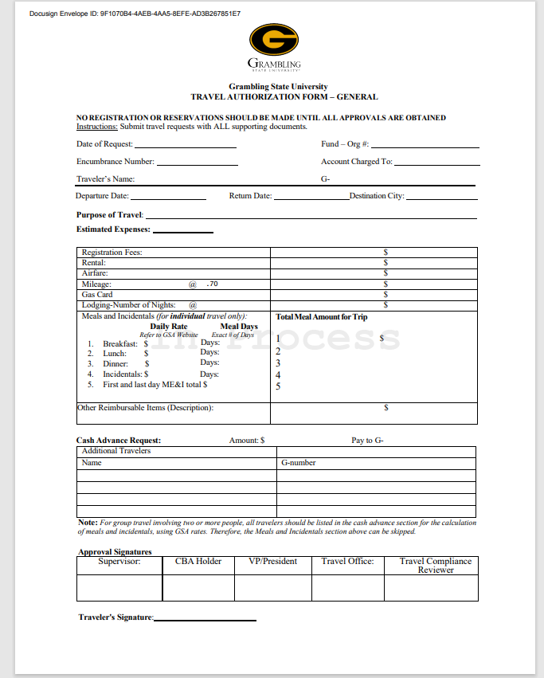
Travel Request Authorization
Complete Travel Authorization through DocuSign and attach the applicable documents!
ALL Travel authorizations must be submitted 30 days prior to travel.
You must have an approved travel from the Travel Office before departure.

Slide 12
Registration
The invoice must be attached to the travel authorization, indicating the registration fee amount.
If payment for registration is due by a specified deadline, include a comment on the travel authorization stating the due date.

Slide 13
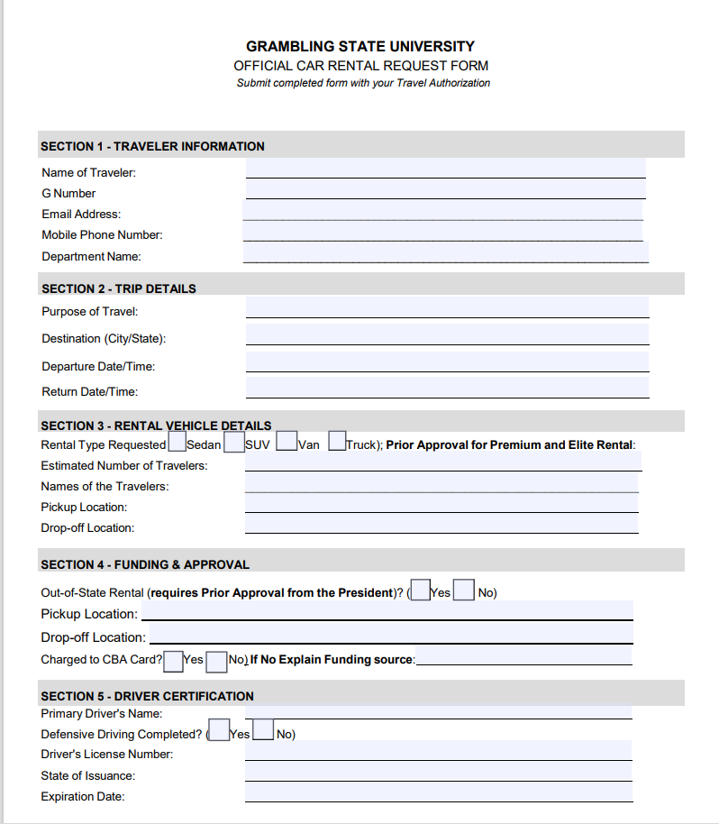


RENTAL VEHICLES
The state has contracts for all vehicle rentals through Enterprise and Hertz, which is mandatory for business travel.
Premium or Special Elite rentals are not permitted.
Prior approval is required for any vehicle upgrades and/or out-of-state rentals.
A formal written justification letter must be submitted to the Program Administrator to be routed for required signatures by the Vice President and President.
Refueling and any violations (including citation) are not permitted. It is the responsibility of the cardholder and approver to ensure the traveler reimburses Grambling State University within three business days of the trip’s return for any refueling or other charges not related to official travel on CBA card.
Please attach Booking Form and Reservation to the Travel Authorization.
Per OST (Office of State Travel) policy, travelers must complete the State-required Driver Defense Course and hold a valid driver’s license in good standing to be authorized to rent a vehicle.
Travelers must provide Ms. Becky Fields with an approved Travel Authorization and Encumbrance to obtain a University Gas Card

Slide 14

AIRFARE
Please do not make any bookings until you have received approval from the Travel Department
Travelers must purchase airline tickets through the state contracted travel agency (Christopherson Business Travel).
Per the State of Louisiana, travelers are to seek airfare allowing an ample amount of lead-time prior to departure date. The lead-time should be about (10) ten to (14) fourteen days in advance of travel dates to ensure the lowest fares are available.
Please do not make any bookings until you have received approval from the Travel Department!

Slide 15
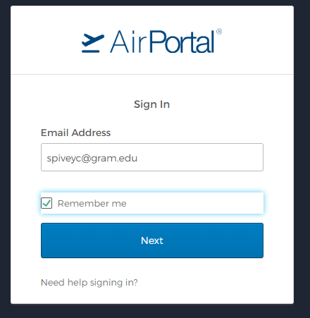
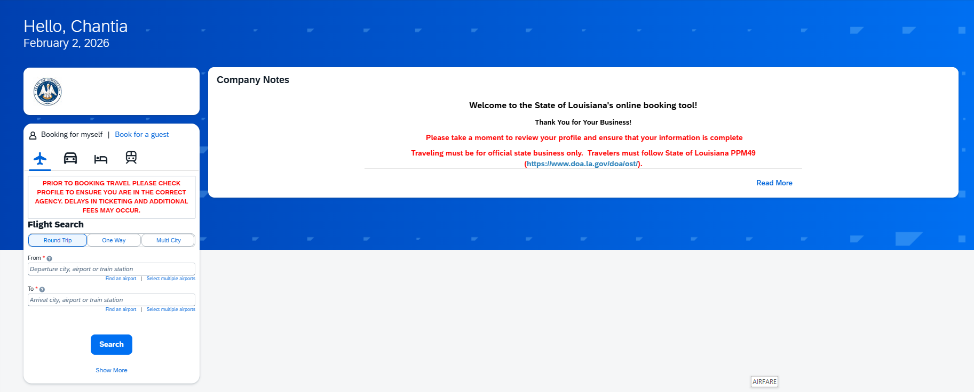
HOW TO BOOK FLIGHT
Create a profile
  https:/airportal.cbtat.com/enroll/STATEOFLA
  Once profile is created, then you will receive a welcome email within 24 hours
Login into AirPortal
Book/Manage Online Trips
Search Flight
Screenshot quote and attach it to the travel authorization
Once the travel authorization has been approved, you will be notified by the travel team to book the flight
For payment- Select the CBA card ending in 1111
To book on behalf of another individual, you must contact Christopherson via email at Onlinesupport@cbtravel.com to request “book as guest” be added to your profile

Slide 16
LODGING
Reservation confirmation number must be in the traveler’s name
Screenshot of the GSA rate for the destination area is required
  https://www.gsa.gov/travel/plan-book/per-diem-rates
  https://allowances.state.gov/web920/per_diem.asp
Prior approval form the Vice President and President is required if lodging exceeds 49% of the GSA rate, in accordance with University policy. Overage over the 49% will require the Commissioner approval.
A personal credit card is required when making the reservation
  No incidental charges are allowed on the University CBA card
The traveler, cardholder, and approver will be responsible for any incidental charges
Travelers are responsible for submitting the hotel credit card authorization form to the travel office.
ALL hotel receipts must be submitted 3 business days of return trip.
Traveler must obtain a receipt before leaving the hotel.

Slide 17
LODGING continued…..
Routine Lodging – Lodging rate, plus tax and any mandatory surcharge is allowed . When two or more on official state business share a room, the State will allow the actual cost of the room; subject to maximum amount allowed for an individual traveler times the number of employees.
Conference Lodging –Documentation must be attached showing the actual conference rate.
Resort fees are allowed effective July 1, 2026, but the rate and fee cannot be more than the GSA rate for the area, not including conference rate for the actual conference hotel.
You must provide the Hotel with a Hotel Tax Exemption Form for In-State Lodging upon arrival.
NO Louisiana state tax is acceptable on the card, if so it must be credited by the vendor or reimbursed by the cardholder, approver, and traveler. Non-state occupancy or other taxes on hotels are acceptable. Sale tax is allowed for parking, if on hotel invoice.

Slide 18
INTERNATIONAL Travel
International travel must be approved by the President
https://allowances.state.gov/web920/per_diem.asp
International GSA Rates

Slide 19
ADJUSTMENTS TO THE TRAVEL
A Travel Adjustment Form must be submitted when there are changes to an existing or approved travel request, including any of the following:
  Changes or additions to the traveler’s name
  Cancellations
  Increases in trip costs, including:
    Hotel
    Airfare
    Registration fees
    **Form is located on the travel webpage: https://gram.edu/offices/infotech/teleworking/travel.php

Slide 20
Travel request denials
Travel requests may be denied within ten (10) business days of travel if required documentation or prior approvals are missing, or if the request does not comply with University or State travel policy.
Common Reasons for Denial
  Missing or incomplete documentation
  Required prior approval letters not submitted
  GSA rate documentation not provided
  Payroll deduction form not submitted
  Incomplete or unapproved encumbrances

Slide 21
OTHER IMPORTANT INFORMATION
The State CBA Card is to be used for official university business only. Violators of policies & procedures will be subject to disciplinary action.
  Violations:
    Personal or unauthorized purchases such as hotel incidentals
    Alcohol
Failure to comply with all State CBA Card policies & procedures may result in the following:
  Payroll deduction
  Loss of travel privileges on GSU CBA Card
  Notification to administration, internal audit, Office of State Travel, LLA (Louisiana Legislative Auditor) and University Police
  Possible employment suspension or termination

Slide 22

Questions?

